Slide 1
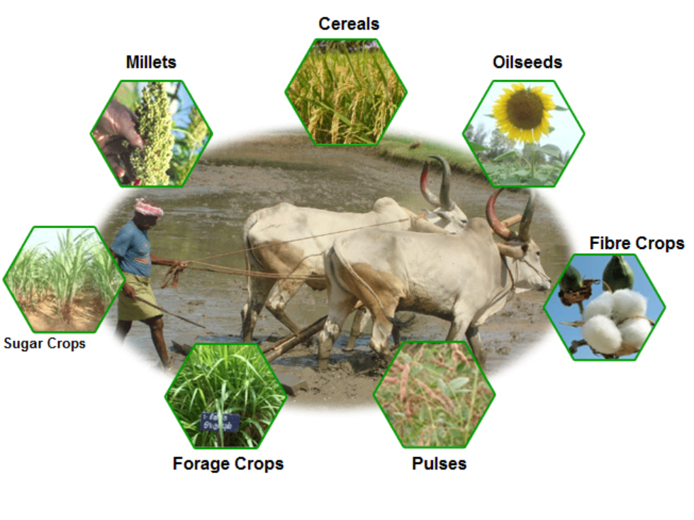
TOPIC : CROP RECOMMENDATION SYSTEM
TEAM NAME : CODEBITZ
TEAM MEMBERS :
SHYAMAL KACHA
DARPAN RANA
DHAIRYA PATEL
KRISH PARIKH

Slide 2
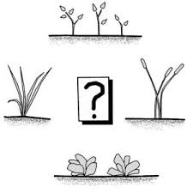
INTRODUCTION
There are numberous problems which are faced by our farmers daily. One of the them is grow the correct crop according to the climate, type of soil and various other factors. Thus this Crop recommendation project involves advising farmers on the most suitable crops. It helps farmer to grow crops based on various factors such as soil quality, climate conditions, and market demand. This project ensures to help the farmer by recommending the right crop at right time.This project offer tailored solutions to enhance crop productivity, ensure efficient use of resources, and maximize economic returns.

Slide 3

PROBLEM STATEMENT
The problem of crop recommendation is underscored by several critical challenges that impact agricultural efficiency, sustainability and productivity. Farmers often face uncertainty due to varying soil conditions, unpredictable weather patterns, and changing climate conditions, which can lead to suboptimal crop choices and reduced yields. Traditional methods of crop selection which are based on historical data Inadequate crop recommendations not only undermine agricultural productivity but also hinder efforts to adapt to environmental changes and achieve long-term sustainability in farming practices.

Slide 4
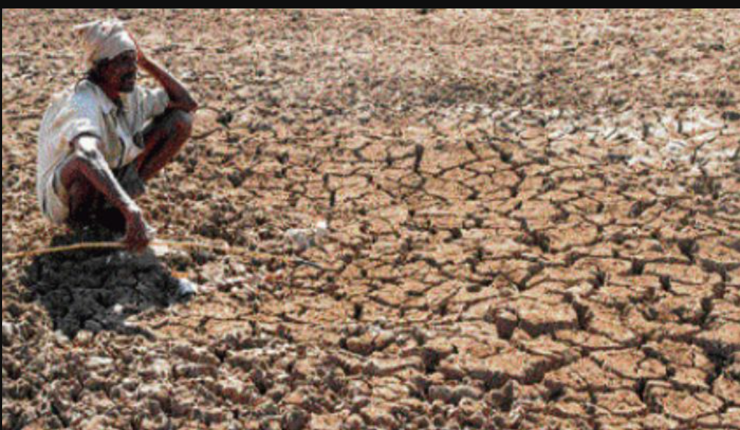
WHAT HAPPENS IF CROP RECOMMENDATION SYSYEM IN NOT IMPLEMENTED
Reduced Crop Yields: Without proper recommendations, farmers may plant crops that are not suited to their soil or climate, resulting in lower yields and wasted resources.
Inefficient Resource Use: Misalignment between crops and environmental conditions can lead to excessive use of water, fertilizers, and pesticides, increasing costs and harming the environment.

Slide 5
Economic Losses: Farmers may face financial losses if they grow crops that are not in demand or do not fetch good market prices, affecting their profitability and economic stability.
Environmental Degradation: Poor crop choices can lead to soil depletion, increased erosion, and higher pesticide and fertilizer runoff, contributing to environmental pollution and degradation.
Increased Risk of Crop Failure: Inappropriate crop selection increases the likelihood of crop failure due to unfavorable conditions, pests, or diseases, leading to financial and food security issues
Decreased Crop Diversity: Failing to diversify crops can make farming systems more vulnerable to pests, diseases, and market fluctuations. Reduced crop diversity can also limit ecological benefits and resilience.

Slide 6
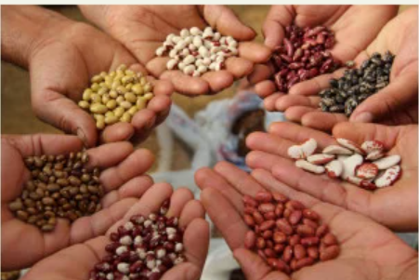
WHY CROP RECOMMENDATON IS NEEDED?
Maximizes Yield: By recommending the best-suited crops for specific soil types, climates, and conditions, crop recommendations help farmers achieve higher yields.
Enhances Soil Health: Recommending crops that fit into a rotation plan can help prevent soil degradation, nutrient depletion, and erosion, promoting long-term soil fertility.
Reduces Pest and Disease Incidence: Recommending crops that are less susceptible to local pest and disease pressures can reduce the need for chemical treatments and improve overall crop health.

Slide 7
Optimizes Resource Use: By recommending crops that are well-adapted to the available resources, farmers can reduce waste and improve resource efficiency.
Risk Management: Recommending crops that are resilient to local pests, diseases, and climatic conditions can help mitigate risks and reduce the likelihood of crop failure
Economic Viability: Crop recommendations can guide farmers towards crops that have higher market value or better demand in their region, improving their income and economic stability.
Adaptation to Climate Change: As climate patterns shift, crop recommendations can help farmers adapt to new conditions by suggesting crops that are more likely to succeed under changing circumstances.

Slide 8
ACTION PLAN
First we will collect the required data from reputable sources.
Then we will clean the data and transform it into required type and analyze it (Data cleaning and preprocessing).
We will create an efficient and accurate machine learning model using the collected data.
Then the model will be tuned accordingly to achieve the goal.
The trained model will be used with GUI application to solve the problem statement.

